Slide 1

ITER Organization - ARIBA IPROC Supplier Registration Guidelines
ADM/PRD – 22nd April 2026

Slide 2

ITER Organization - ARIBA IPROC Supplier Registration Guidelines
Guidelines:-
How to register in ARIBA upon receipt of ARIBA invitation email
How to complete the ITER Supplier Registration Questionnaire

Slide 3
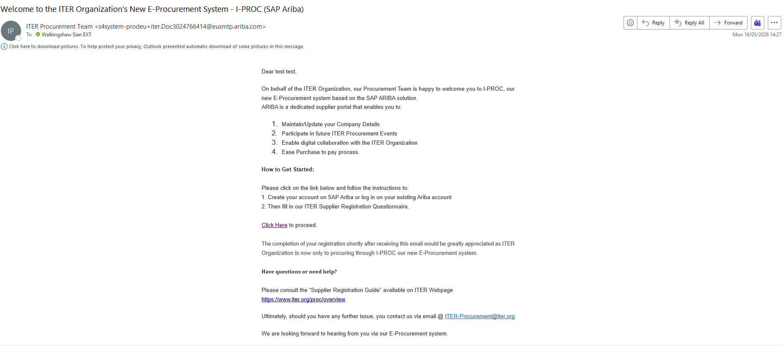

1. How to register in ARIBA upon receipt of ARIBA invitation email
You will receive an invitation email that looks as follows
Please select “Click Here” to commence registration.

Slide 4
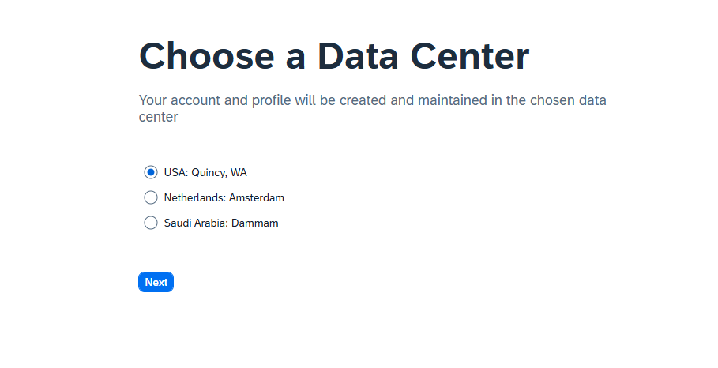
1. How to register in ARIBA upon receipt of ARIBA invitation email
Guidelines - Identify where your company and customers operate.
Most organizations choose the date center region closest to their legal entity or to where their customers require data residency.
Please be aware that once the account is created you will be unable to change the Data Center selected.
SAP explicitly states that the data center determines where your data is stored so local regulations should be reviewed.

Slide 5
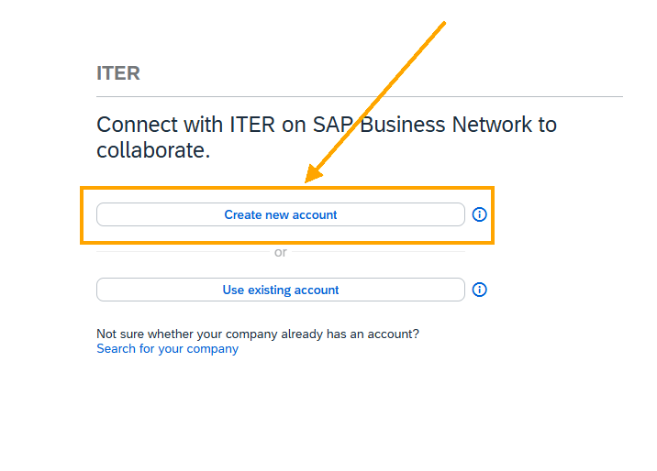
1. How to register in ARIBA upon receipt of ARIBA invitation email
Select “Create new account” (Note: If you have other ARIBA accounts, they may be linked later in the process).

Slide 6
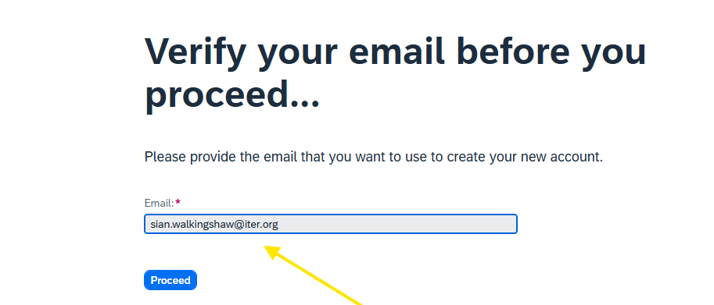
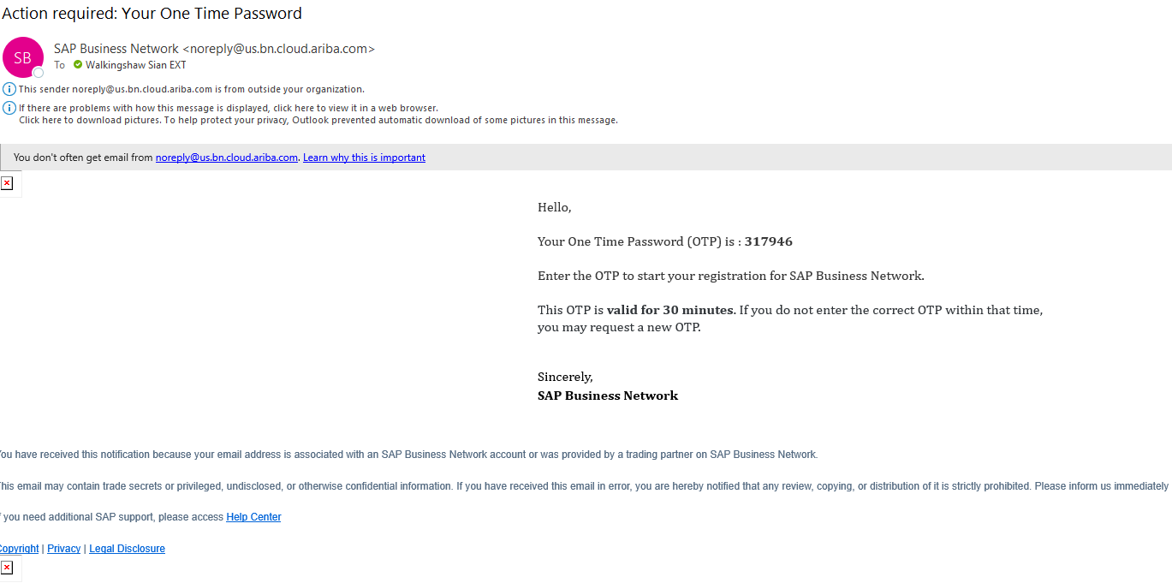
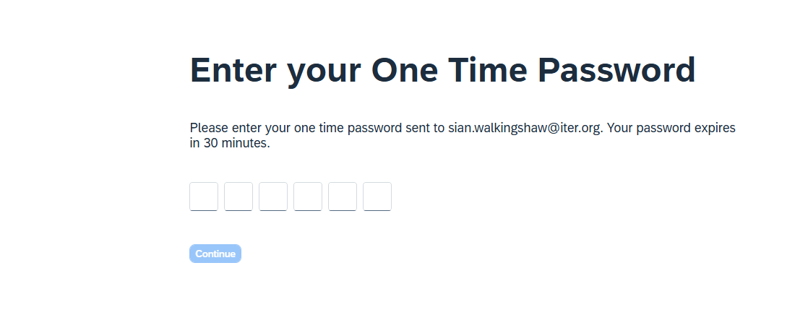
1. How to register in ARIBA upon receipt of ARIBA invitation email
1. This is the email to which the invitation email was sent and cannot be altered at this stage. This will be the designated administrator for the account. However, the email address and thus the administrator can be altered once the ARIBA account is registered.
2. You will receive a One-Time password to verify your email account.
3. Enter the one-time password

Slide 7
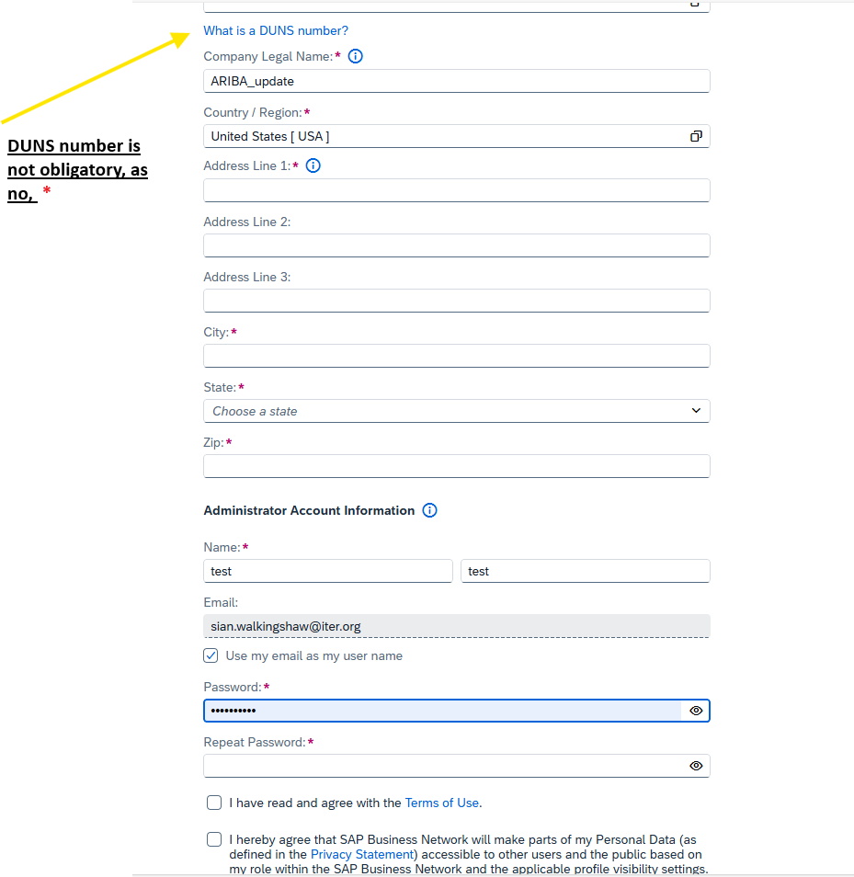
1. How to register in ARIBA upon receipt of ARIBA invitation email
Please complete the company information , only fields marked with a * are obligatory.
Please tick the box “use my email as my username’’, unless you already have another ARIBA account ’’.
Please note if you have an ARIBA account with another customer then you will need to create a unique username, simply add a numeric i.e., john.smith@iter.org becomes johnsmith1@iter.org

Slide 8
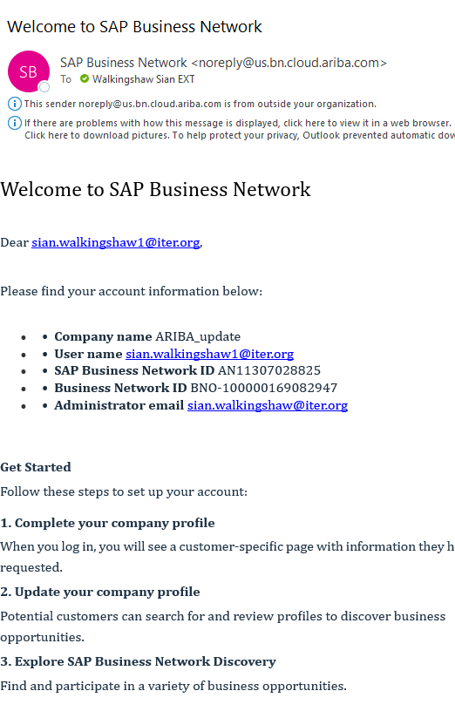
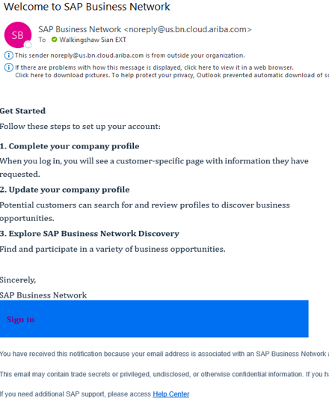
1. How to register in ARIBA upon receipt of ARIBA invitation email
A 1st email confirmation will be received confirmed the activation of the ARIBA account and details relating to it.
A 2nd email will be received including a hyperlink to sign in to your ARIBA account
Sign in to ARIBA using the hyperlink

Slide 9
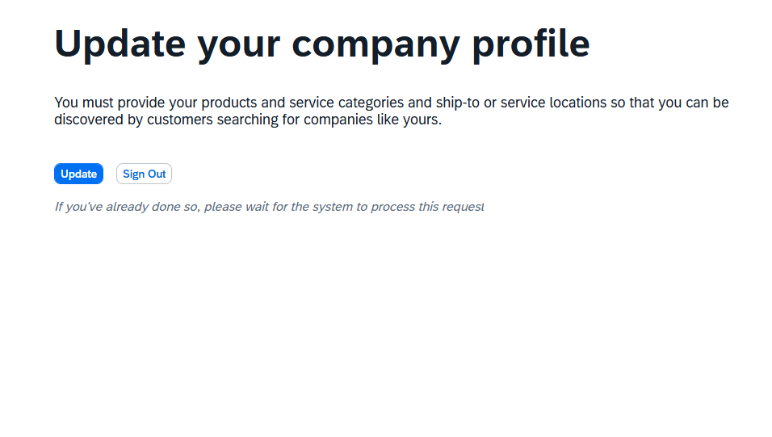
1. How to register in ARIBA upon receipt of ARIBA invitation email
You will be then requested to update your company information with, product/service categories & ship to service locations.
To look up the available codes you may use the link below:-
United Nations Standard Products and Services Code (UNSPSC)

Slide 10
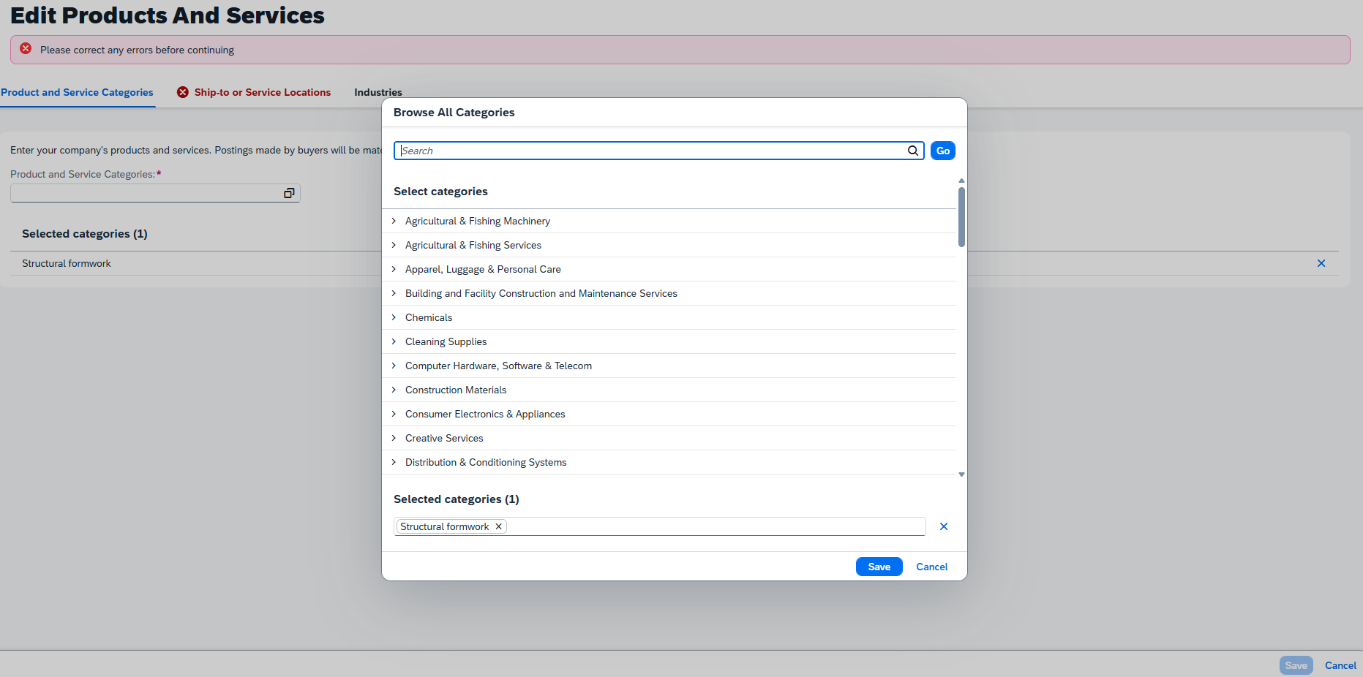
1. How to register in ARIBA upon receipt of ARIBA invitation email
Enter first the Product and Service Category
TIP : Use broad terms and then narrow down the results with more specific options.
Eg: type “Sport equipment” instead of “Golf Club”
Then you can select the exact category
11 / 26

Slide 11
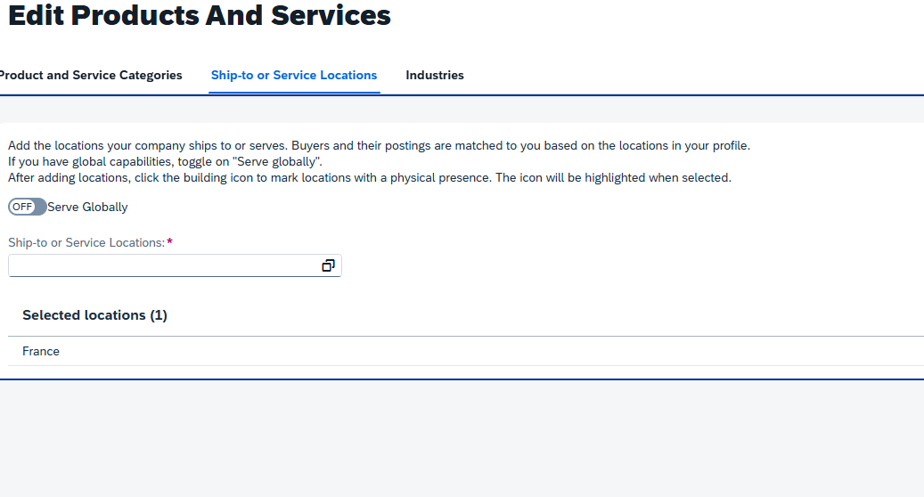
1. How to register in ARIBA upon receipt of ARIBA invitation email
Then select the Ship-to or Service Locations
If your company has no restriction and you do not want to miss any opportunity, select “Serve Globally”.

Slide 12
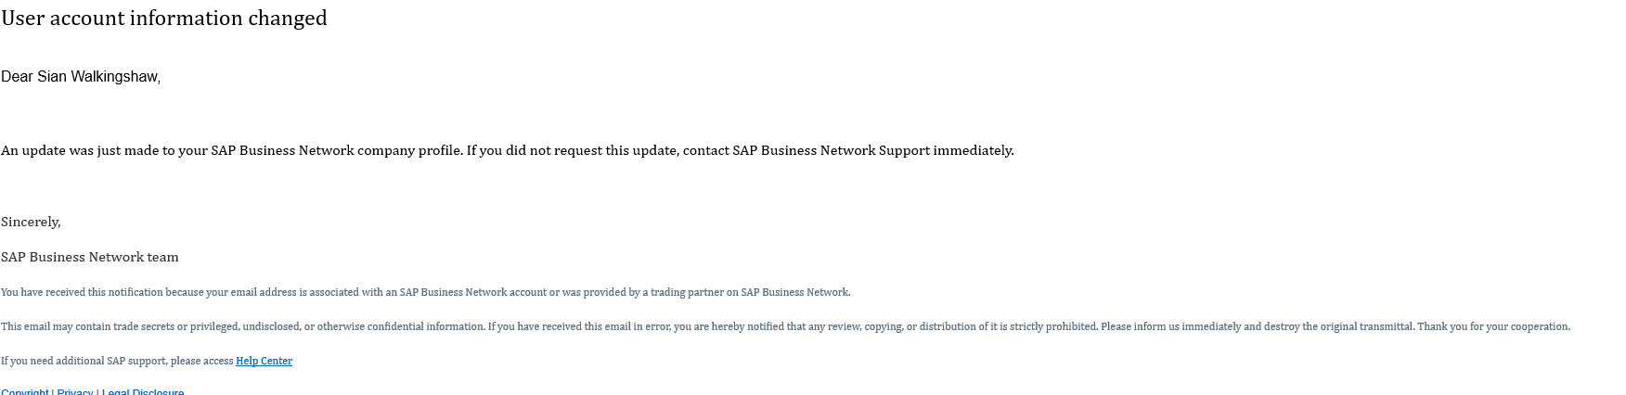
1. How to register in ARIBA upon receipt of ARIBA invitation email
You will then receive an email confirming the changes.

Slide 13
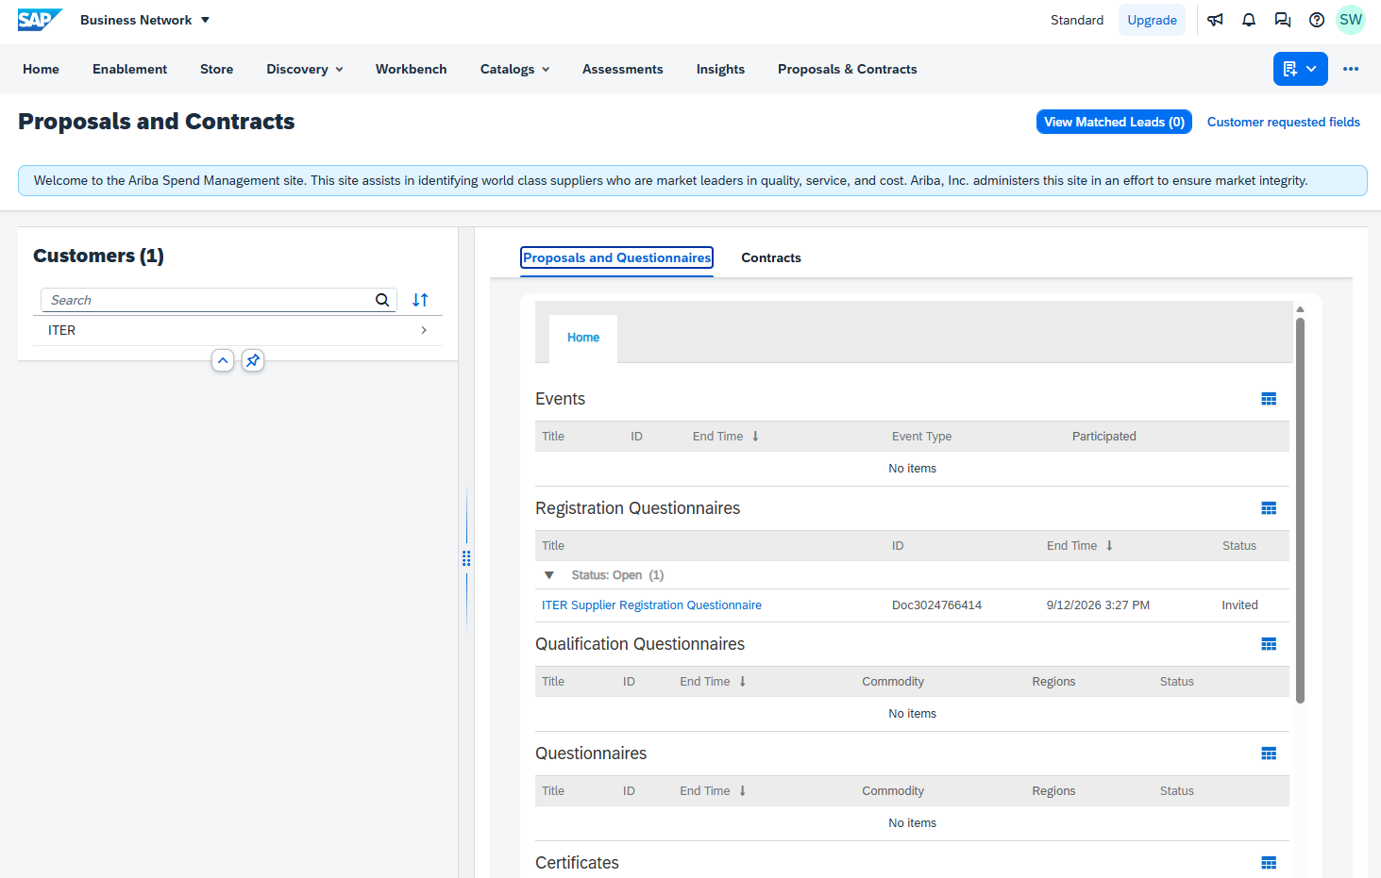
2. How to complete the ITER Supplier Registration Questionnaire
The supplier registration questionnaire is located here.

Slide 14
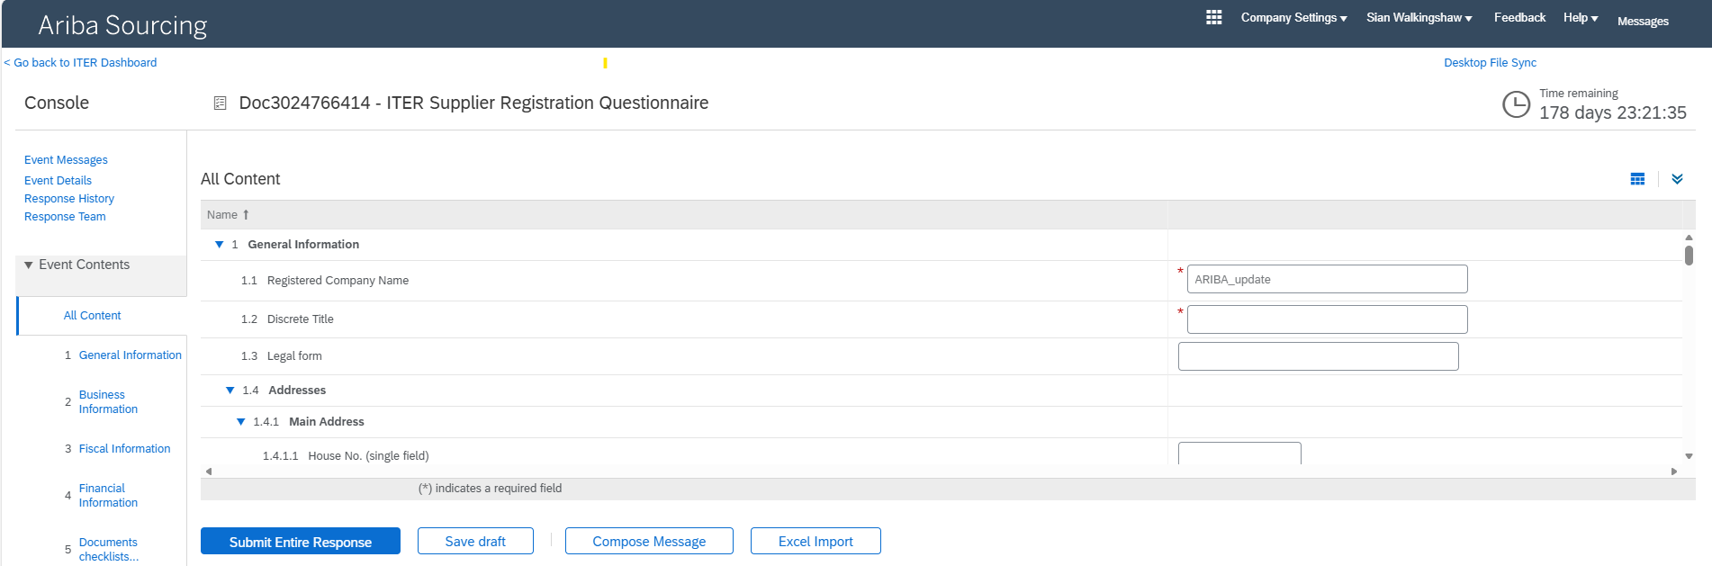
2. How to complete the ITER Supplier Registration Questionnaire
Remaining Time before the Questionnaire expires
If you have any question related to the content of the questionnaire, you can contact the Purchasing Responsible Officer using the integrated messaging system (each message is cc to sender & recipient(s) email account).
Discrete Title is the name the company uses separately from its legal identity (normally an acronym)
e.g.: NASA is discrete title for “National Aeronautics and Space Administration »

Slide 15
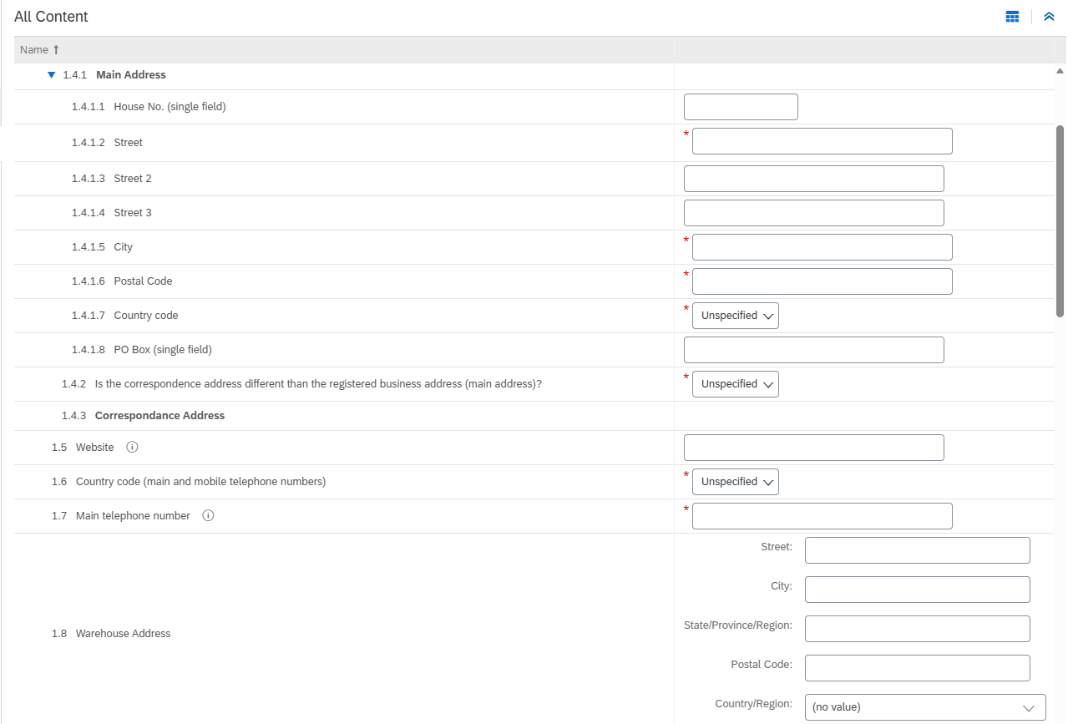

2. How to complete the ITER Supplier Registration Questionnaire
Any field marked with a * (star) is a mandatory field.
You will have to provide information there to finalize your registration.
General Information and Addresses.
Main address is the address related to your company / Tax ID, in other words, the one to consider for any contractual document.
Correspondence address is where and how we can reach our main contact (i.e.: you)
You must select the country code for the phone number (landline or cell phone) from th15e drop-down country code list
Do not put the country calling code (I.e.: 00XX) in front of your number.
Use only a series of numbers (no separator such as : ; . - _ .)
E.g.: French number, Country code is FR
Phone number: 123456789

Slide 16
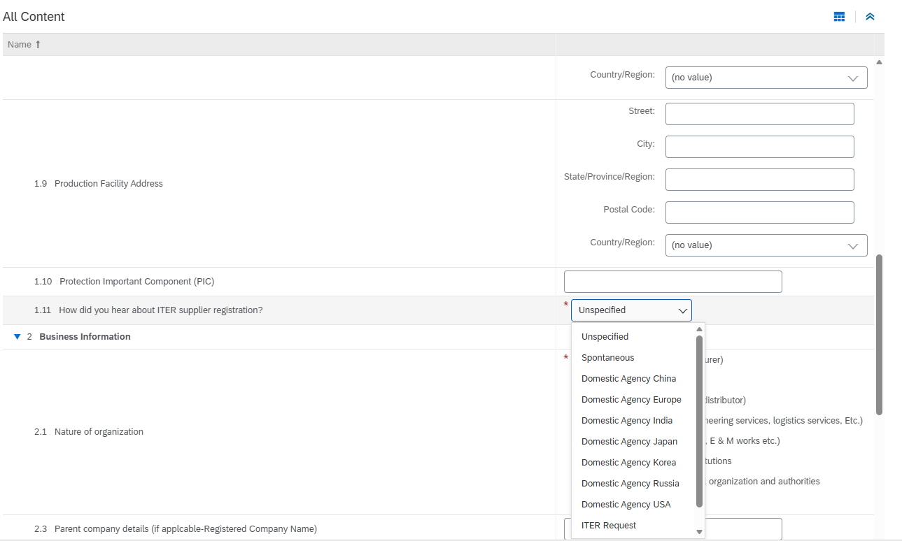
2. How to complete the ITER Organization registration questionnaire
Specify here if you are supplying PIC component (under nuclear safety regulation)
Select how you heard about ITER

Slide 17
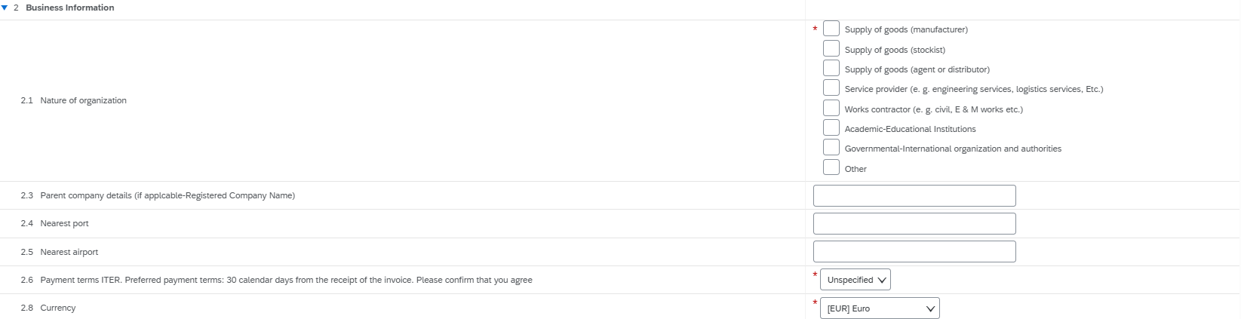
2. How to complete the ITER Organization registration questionnaire
Please specify here the type of activity you are mainly providing.
You can select several values, provided those are significant in your activity.
Please specify here your agreement with our standard payment terms.
Please specify your trading currency.
If you manage several currencies, please note that ITER Organization is preferably dealing in Euros

Slide 18
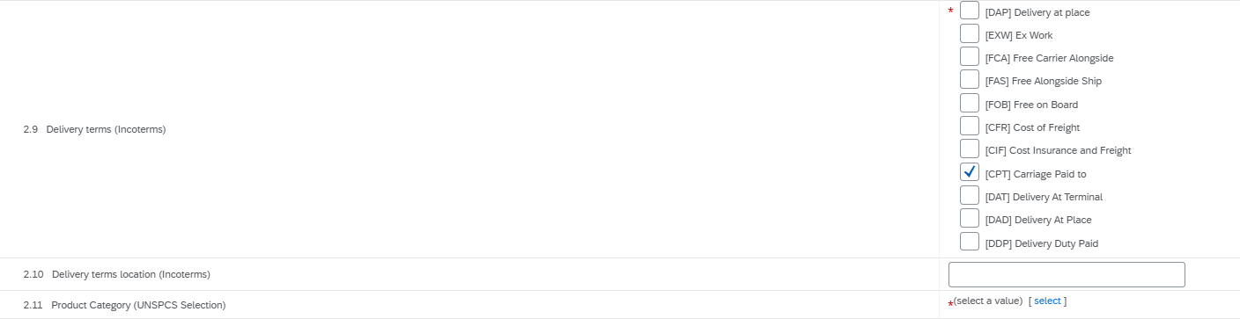
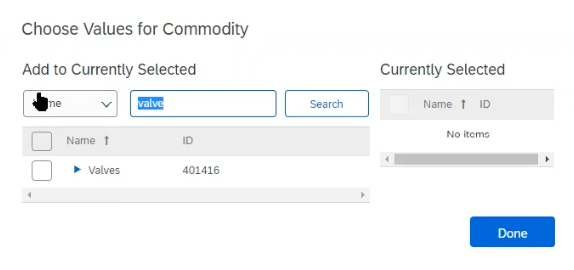
2. How to complete the ITER Organization registration questionnaire
Please specify the standard incoterm you consider in your offers.
This is indicative only and will not prevent ITER Organization to specify in its Request For Proposal any of those incoterm if need be.
Please note the preferred option for ITER is DAP
Select here the scope you consider to be able to supply to ITER Organization, the UNSPC selected in ARIBA registration is what you want to offer to the whole market.

Slide 19
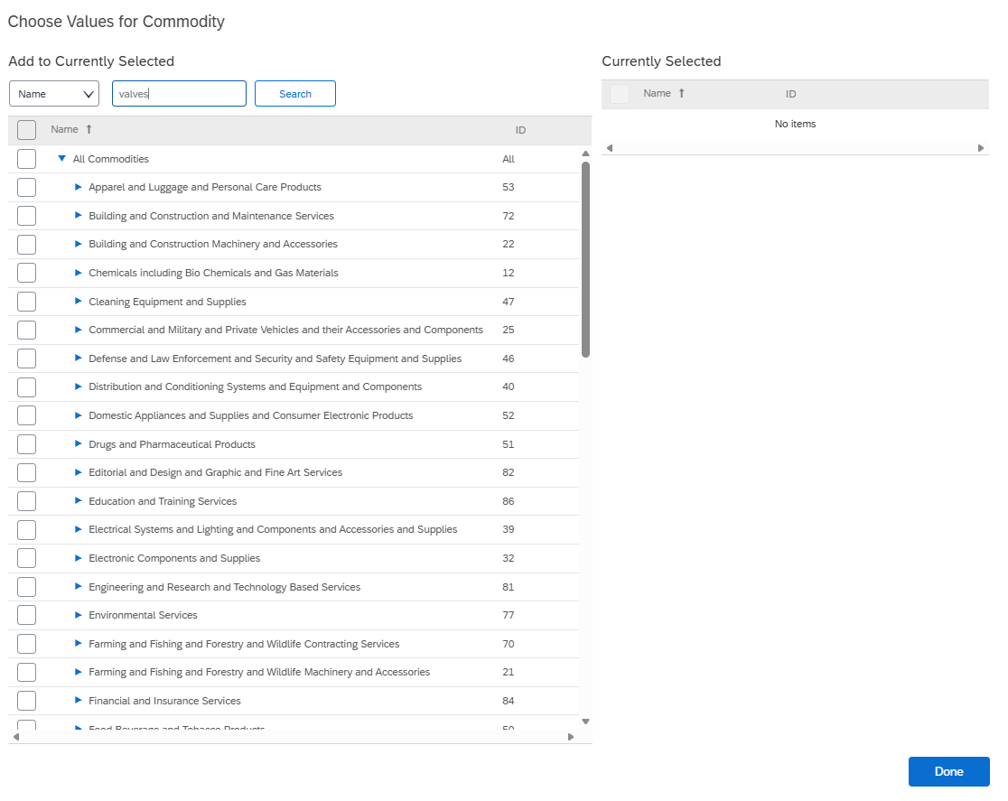
2. How to complete the ITER Organization registration questionnaire
2.11 Product Category (UNSPCS Selection)
Select the general terms, in this case “valves”, and then drill further down, if required to be more specific.

Slide 20
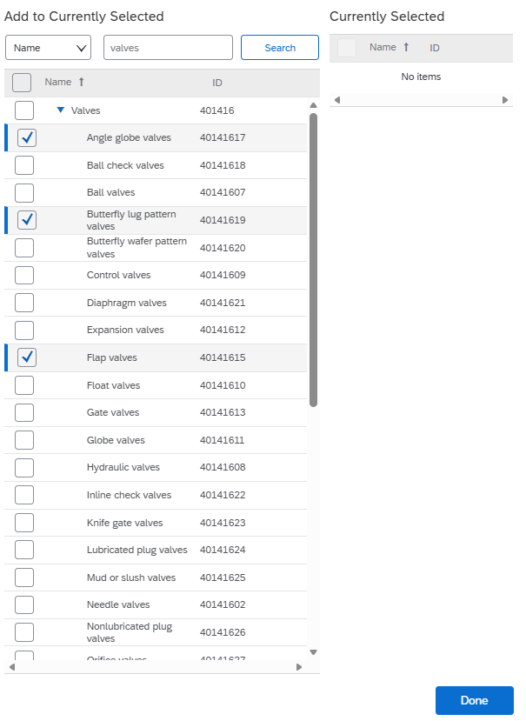
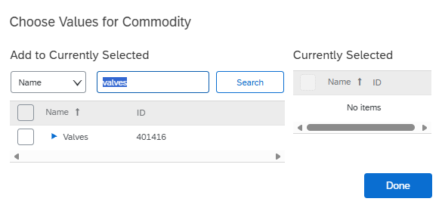
2. How to complete the ITER Organization registration questionnaire
2.11 Product Category (UNSPCS Selection)
Drill further

Slide 21
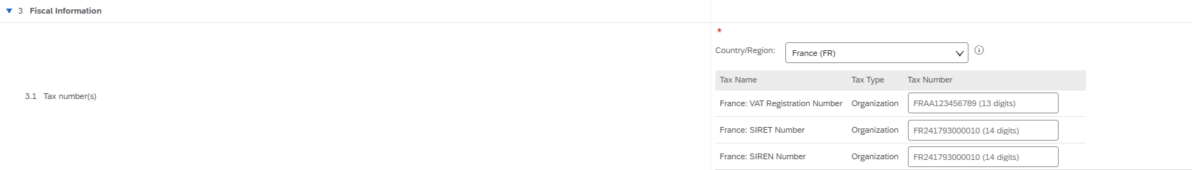

2. How to complete the ITER Organization registration questionnaire
Select the country where your company is registered.
For French suppliers. Enter the SIRET number for both the SIREN & SIRET boxes.
If you still have an error message on 3.1 Tax Number (s), Please put “EU” as the sole value.
It will open the specific registration options for your country.

Slide 22
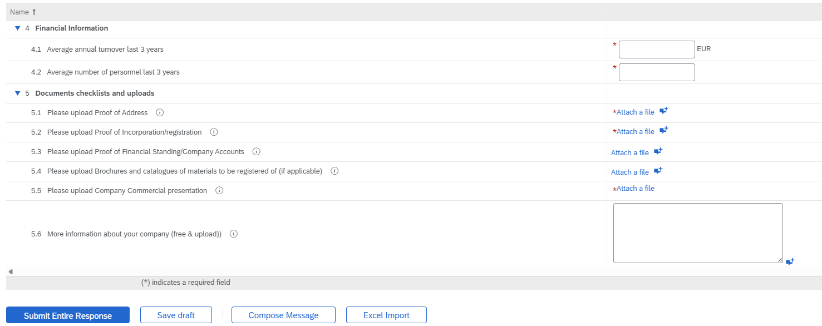
2. How to complete the ITER Organization registration questionnaire
You can complete financial and staff information
Attach, at minimum, the mandatory documents required *.
Complete with a comment or attachment
Once your questionnaire is authorized by the Procurement Team the account will be fully registered.
Then select “Submit”
Once your questionnaire is authorized by the Procurement Team the account will be fully registered.

Slide 23
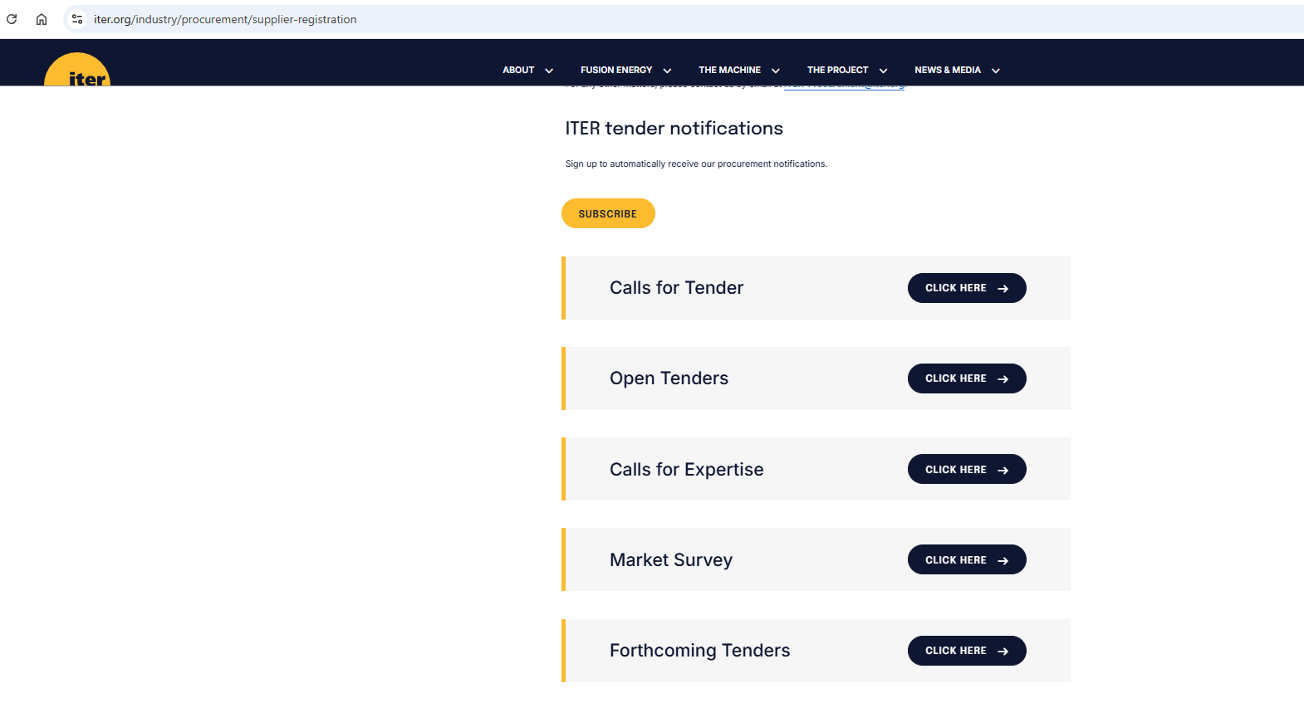
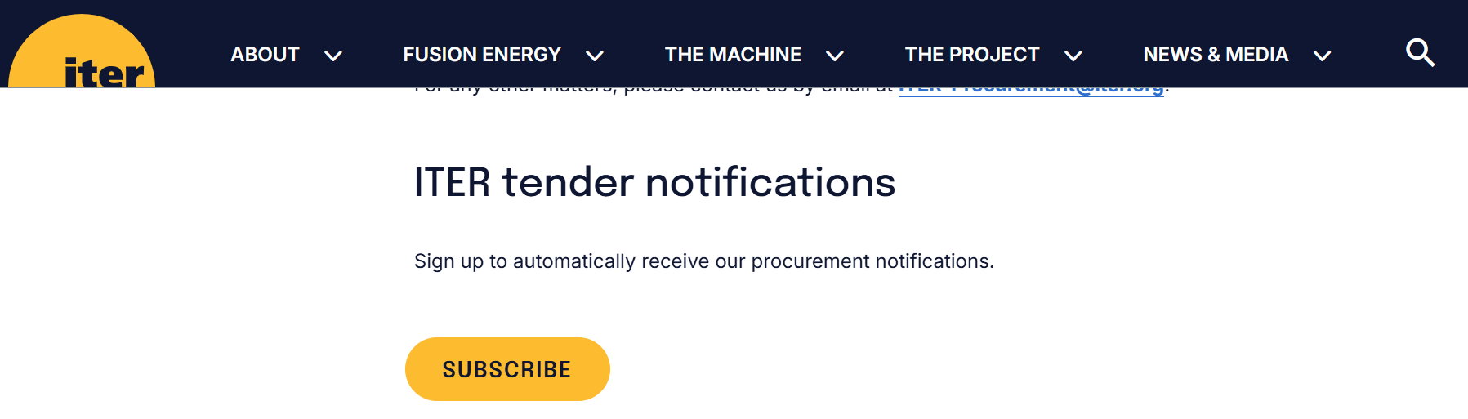
3. How to find out about forthcoming tenders?
Forthcoming tenders are advertised on the ITER website,
Navigate to
https://www.iter.org/industry/procurement/supplier-registration
Please subscribe here for tender notifications.

Slide 24
4. Need help ?
Within the ARIBA account the help center may be accessed, as below, by selecting
Technical Supplier support to ARIBA registration is available in various languages here: https://support.ariba.com/Adapt/Ariba_Network_Supplier_Training/
SAP ARIBA online video training on account creation and management:
https://sapvideo.cfapps.eu10-004.hana.ondemand.com/?entry_id=1_r7o89fjy
Any business-related questions, please contact :
ITER-Procurement@iter.org
Or visit our webpage : https://www.iter.org/fr/proc/overview

Slide 25


